Slide 1


Career & Interview Coach
Week 5: Flow and Architecture
HAI Term Project 2026
Safety, fairness and responsible feedback

Slide 2
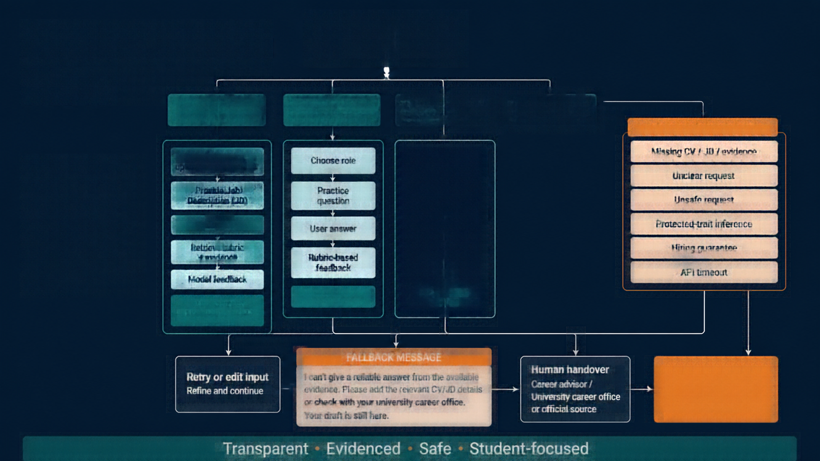

















































Conversation Flow
START
Greeting + AI and limitations disclosure
Improve my CV
Practice interview
Understand feedback
Report unfair feedback
SAFETY & EXCEPTIONS
End-to-end flow for how the Career & Interview Coach supports students across key tasks with safe, evidenced feedback.
Choose role or upload/use fictional CV
Choose role
Why this
feedback?
Missing CV / JD / evidence
Unclear request
Provide Job Description (JD)
Practice
question
Show evidence + rubric criterion
Unsafe request
Validate input
User answer
Thumbs up / Thumbs down
Protected-trait inference
Retrieve rubric
+ evidence
Hiring guarantee
Rubric-based feedback
Share reason
API timeout
Model feedback
Retry / Save
Anonymous
review
Show strengths, improvements, evidence, limitations
FALLBACK MESSAGE
Retry or edit input
Refine and continue
I can't give a reliable answer from the available evidence. Please add the relevant CV/JD details or check with your university career office. Your draft is still here.
Human handover
Career advisor /
University career office or official source
BOT STOPS HERE
Does not impersonate human experts.
Transparent • Evidenced • Safe • Student-focused

Slide 3
















Main Paths & Quick Replies
Four quick replies guide you to
the right conversation path.
Tap to start where you need help.
Where each reply takes you
CV IMPROVEMENT
Upload or paste your CV and get
actionable suggestions.
Hi! I’m your Career & Interview Coach.
What would you like help with today?
INTERVIEW PRACTICE
Choose a role and practice
real interview questions.
Improve my CV
Practice interview
EXPLAIN FEEDBACK
See the evidence and rubric behind
your feedback.
Understand feedback
REPORT UNFAIR FEEDBACK
Report unfair feedback
Flag issues so we can review
and keep feedback safe.

Slide 4
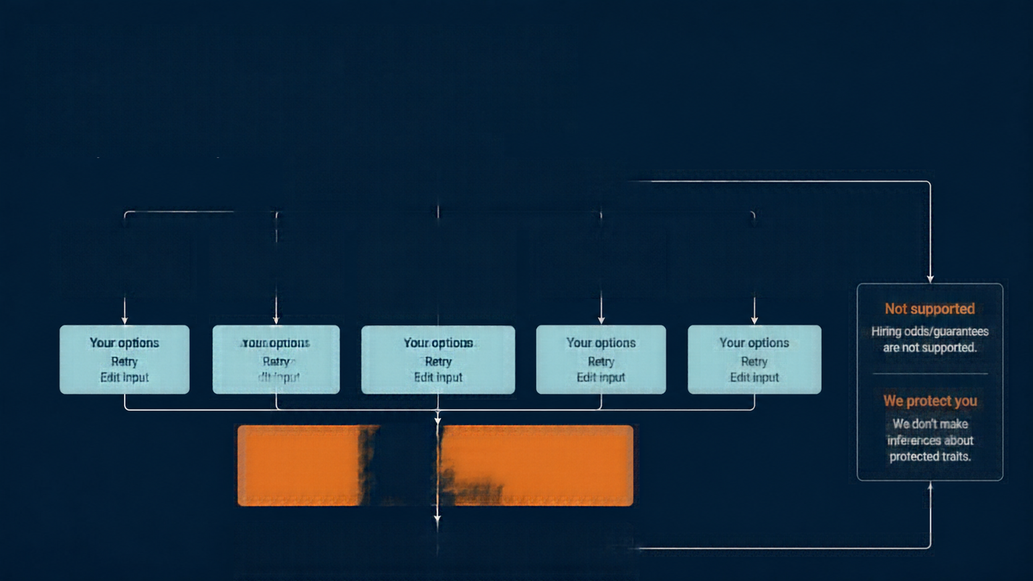



















Error Recovery, Fallback & Human Handover
Safe responses, clear options, and escalation when needed.
Error or boundary detected
Validation failure
Missing data
Unsafe or high-stakes requests
System issues
Other unexpected
missing or invalid CV/JD input
evidence or
rubric unavailable
API timeout
or backend error
errors
hiring guarantees, protected-trait inferences
Not supported
Hiring odds/guarantees are not supported.
Your options
Your options
Your options
Your options
Your options
Retry
Edit input
Retry
Edit input
Retry
Edit input
Retry
Edit input
Retry
Edit input
We protect you
We don’t make inferences about protected traits.
Safe fallback response
I can’t give a reliable answer from the available evidence. Please add the relevant CV/JD details or check with your university career office. Your draft is still here.
Human or official source
Career advisor / University career office / Official source

Slide 5
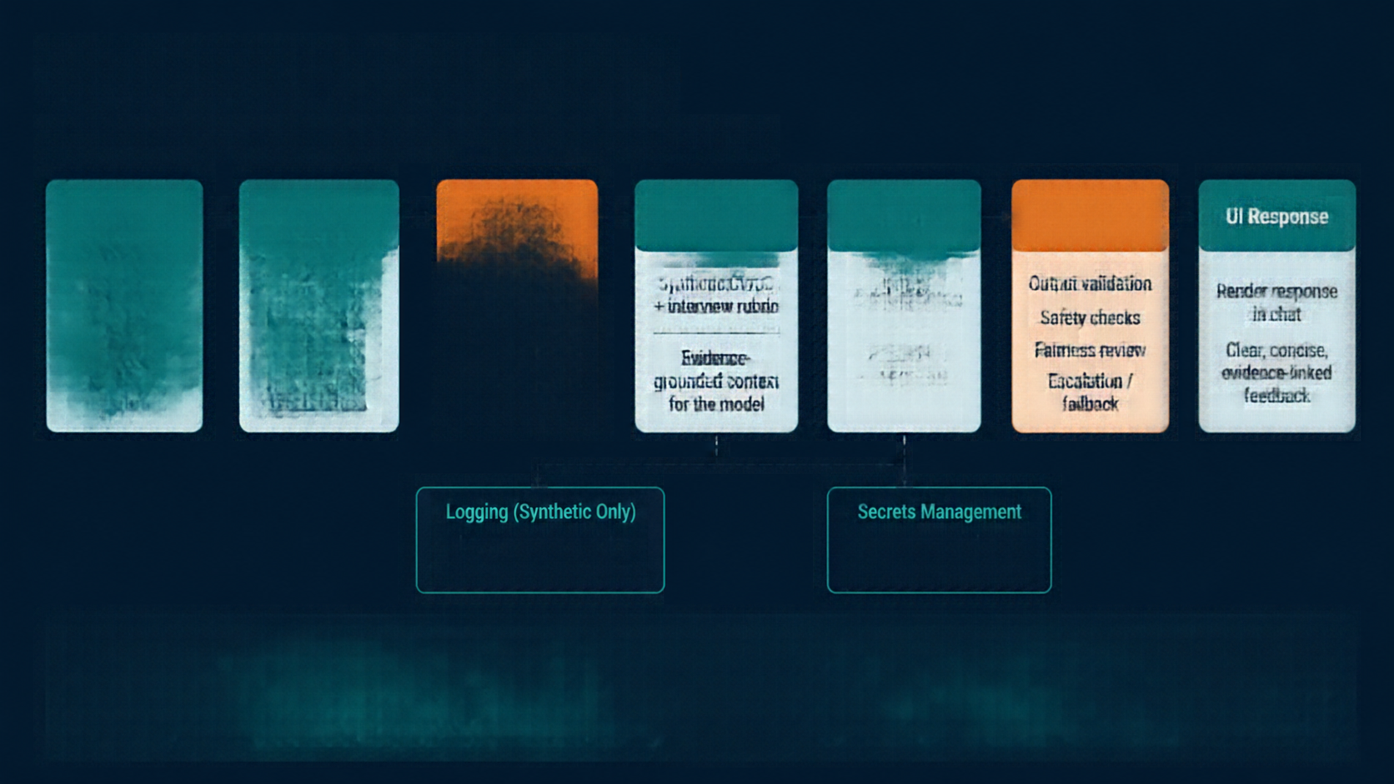
















System Architecture
End-to-end flow from user input to safe, evidence-based feedback.
FastAPI Backend
Safeguards
Retrieval &
Grounding
LLM Provider
Safeguards
UI Response
(Post-Model)
Accessible
web chat
Input validation
Input boundary
checks
Synthetic CV/JD
+ interview rubric
Model inference
Render response
in chat
Session & draft handling
Safety checks
HTML/CSS/
vanilla JS
Evidence:
grounded context
for the model
PENDING
SELECTION
Clear, concise, evidence-linked feedback
Routing &
orchestration
Unsafe request
detection
Escalation /
fallback
Logging (Synthetic Only)
Secrets Management
Log synthetic/test data
Collect anonymous feedback
Environment variables
Never committed to Git
Design Principles
SAFE BOUNDARIES
EVIDENCE-GROUNDED
FAIR & INCLUSIVE
ESCALATION & FALLBACK
Fair, safe, and evidence-first at every step.
Checks before and after the model.
Responses grounded in synthetic CV/JD and interview rubric.
Fairness reviews
across the pipeline.
Unsafe or low-confidence cases escalated.

Slide 6
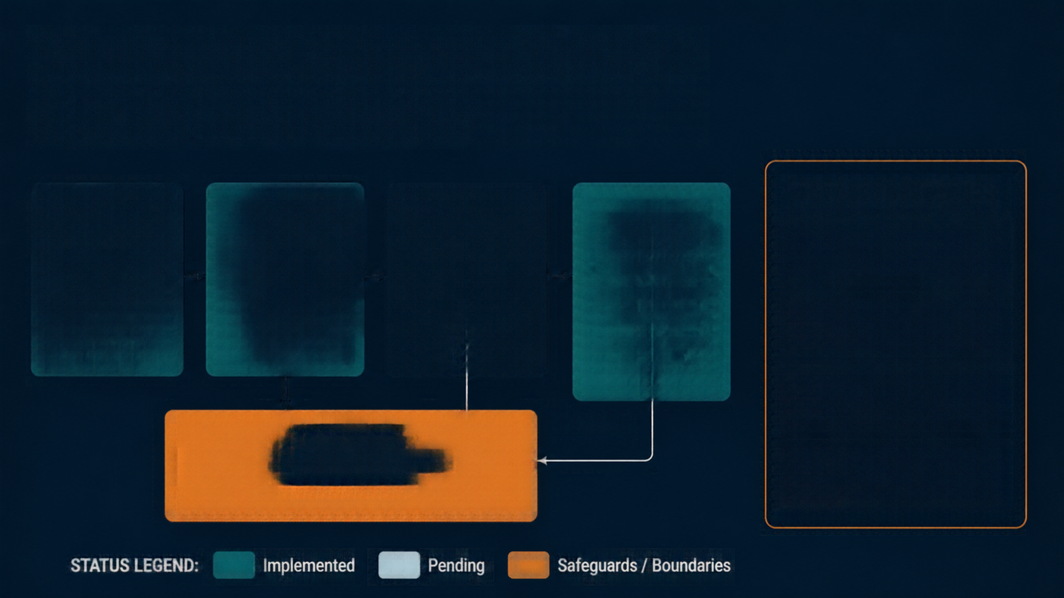

















Component Responsibilities & Data Boundaries
DATA BOUNDARIES
INTERFACE
BACKEND
MODEL
KNOWLEDGE
SOURCES / TOOLS
No real applicant CVs
stored or processed
User inputoutput
Quick replies
Validation
Session management
Routing
Safeguards
LLM call
(pending provider,
model, version)
Synthetic dataset
(10 fictional CVs,
5 fictional JDs)
(proposed/implementedd)
API keys
kept secret
Interview rubric
(proposed)
(proposed/implementedd)
No protected traits
inferred
SAFEGUARDS
Reject protected-trait inference
No hiring prediction
Refuse unsafe requests
Comply with university
policy and applicable law
STATUS LEGEND:
Implemented
Pending
Safeguards / Boundaries

Slide 7






Shneiderman’s 8 Golden Rules Checklist
GOLDEN RULE
DESIGN IMPLEMENTATION (PLANNED)
Consistency
Consistent labels, buttons, and statues across all screens
Shortcuts
Quoik replies, templates, and easy retry options
DESIGN MAPPING
NOT TESTED YET
Informative feedback
Status messages for upload, processing, errors, and evidence
Closure
Summary screens and clear save & finish states
Error prevention / handling
Input validation and clear recovery paths
Easy reversal
Edit input, retry, change focus, clear draft with confirmation
User control
Choose path, set feedback focus, accept or reject suggestions
Reduce memory load
Selected role, rubric, progress, and evidence shown inline

Slide 8
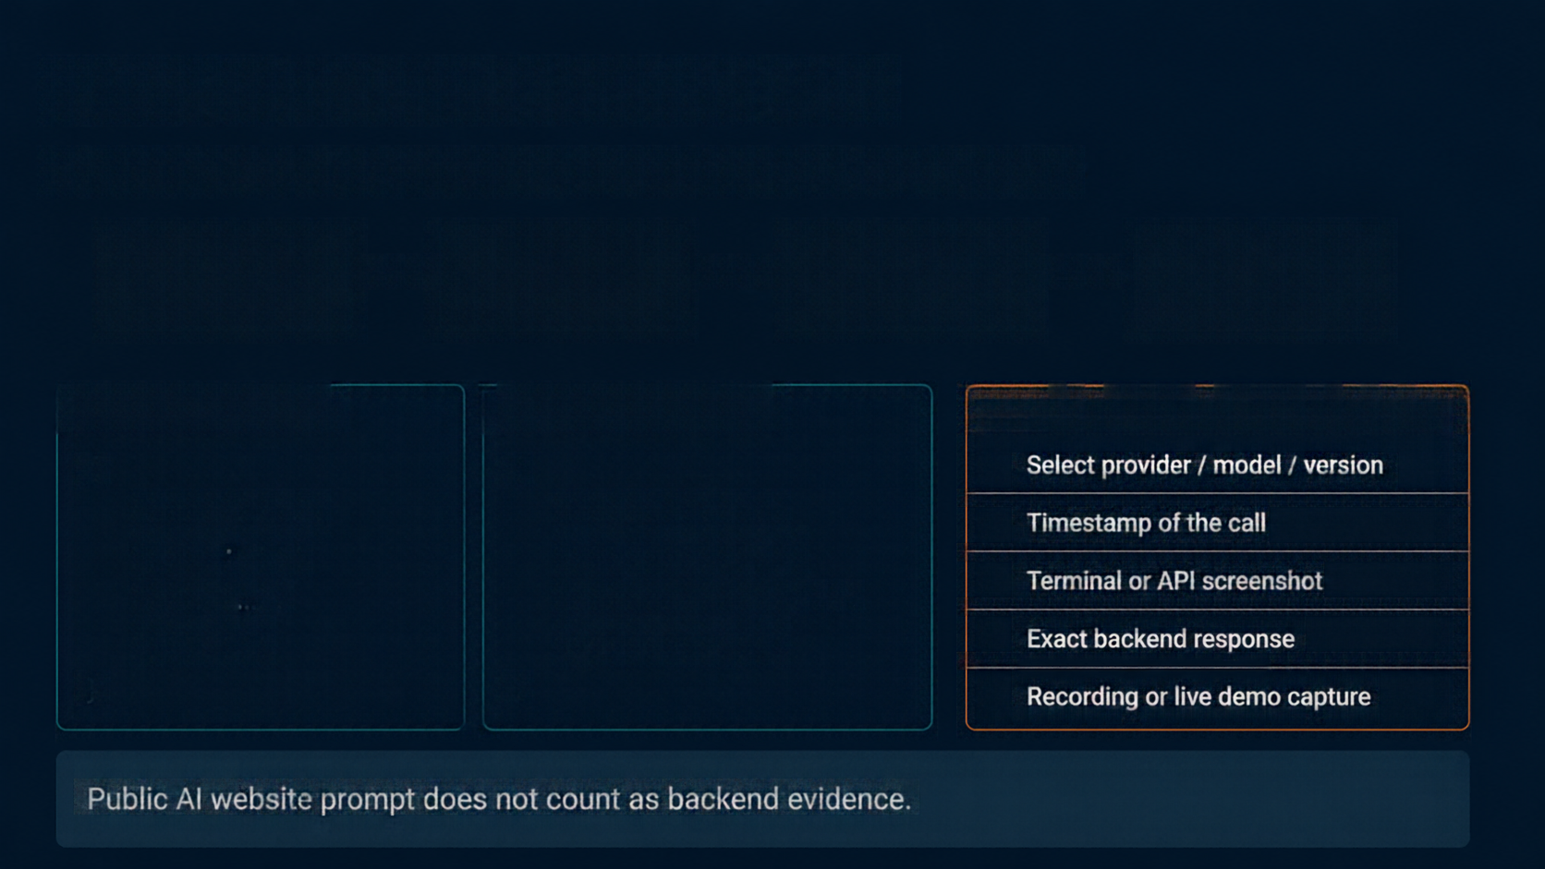













First Backend Model Call
Evidence pending
— not yet verified in supplied project files
POST /chat
FastAPI
Chosen model
Response
request
backend
(provider)
returned
SAMPLE REQUEST JSON
SAMPLE RESPONSE JSON
EVIDENCE TO COMPLETE
{
{
Select provider / model / version
"input" : "...",
"feedback" : "...",
Timestamp of the call
"role" : "...",
"strengths" : "...",
Terminal or API screenshot
"cv" : "...",
"improvements" : "...",
"jd" : "..."
"evidence" : "..."
Exact backend response
}
}
Recording or live demo capture
Public AI website prompt does not count as backend evidence.

Slide 9







Appendix A — Prompt Log
Record prompts used in this week's design task.
Placeholders shown below to be replaced with verified outputs and revisions.
#
Tool
Exact Prompt
What It Gave
Team Changes / Why
1
TBD
[paste exact prompt used
for Week 5 task]
[placeholder for tool output or response]
[placeholder for revisions
and rationale]
(Week 5)
TBD
[paste exact prompt used
for Week 5 task]
[placeholder for tool output or response]
[placeholder for revisions
and rationale]
2
(Week 5)
3
TBD
[draft template from earlier
support pack — verify before use]
[not run — pending
verification]
[confirm need and
final adjustments]
(Week 3–4)
4
TBD
[draft template from earlier
support pack — verify before use]
[not run — pending
verification]
[confirm need and
final adjustments]
(Week 3–4)
IMPORTANT
Include only Week 5 prompts that were executed.
Earlier Week 3–4 prompts remain draft templates until verified.
All fields are placeholders.
Replace with actual prompts, outputs, and reasons.

Slide 10




5-Minute Check-in Run Sheet
+ Completion Checklist
TIMING GUIDE (5 MINUTES TOTAL)
COMPLETION CHECKLIST
0:00
Introduction and
principle overview
01
Test FastAPI backend from own environment
02
Select and record model provider/model version
0:30
Conversation flow walkthrough
03
Save actual request and response data
1:45
Architecture and safeguards explanation
04
Capture live or recorded demo session
05
Validate conversation flow end-to-end
3:00
Shneiderman’s 8 Golden Rules mapping
06
Update prompt log with actual entries
4:00
Backend evidence status and next steps
07
Confirm principle and track with instructor
SOURCE NOTE:
based on HAI Term Project 2026 brief and Week 3 & Week 4 support packs;
proposed items are not results

